Slide 1
Calculator using series and sequence

Slide 2
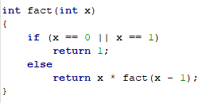
The Factorial Function
2
2

Slide 3

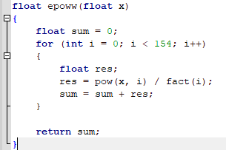
e^x function
3

Slide 4
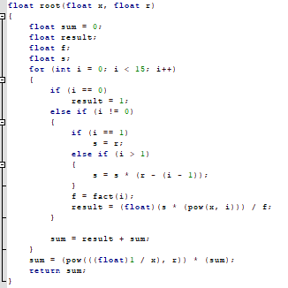

The nth root Function
# The problem here is that the radius of Congreves is only 1
# This means that this series cannot work with values more than one.
# we solved this by taking the user input and use its reciprocal if the values are bigger than one.
4

Slide 5
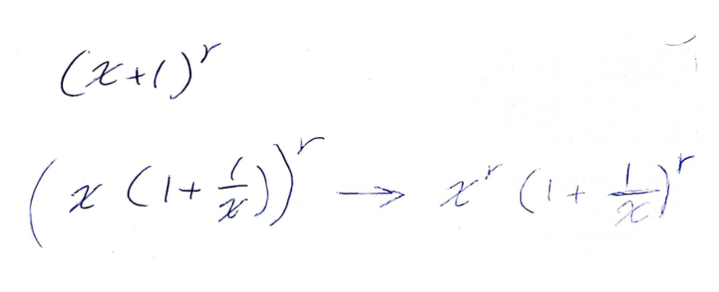

5

Slide 6
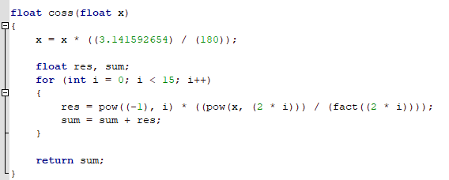
The Cos Function
6

Slide 7

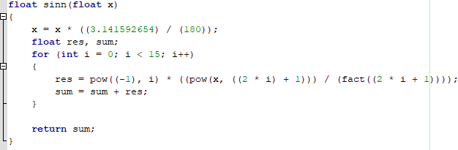
The Sin Function
6

Slide 8
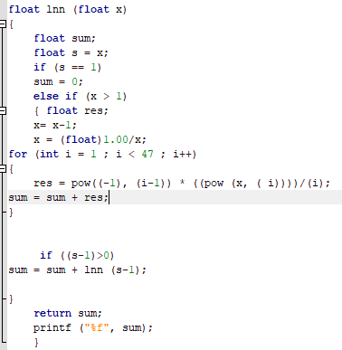
The Ln Function
The problem here is that the radius of Congreves is only 1
This means that this series cannot work with values more than one.
we solved this by taking the user input and use its reciprocal if the values are bigger than one.
7

Slide 9
Assume that the user input is (C)
Since the series deals with (X+1)
We will take the X = C – 1 and deal with X
Ln (x+1) can be written as Ln(x(1+1/x))
Which is the same as
Ln (1 + 1/x) + ln(x)
So we can use the series to solve then Ln(1+1/x) then add it to ln (C - 1)
Which can be used with recursion function to calculate ln(1+1/x) and then add it to the Ln function of (C -1 )
8

Slide 10
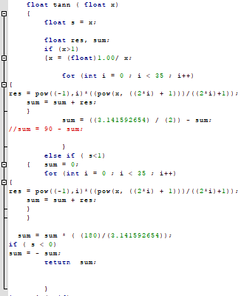

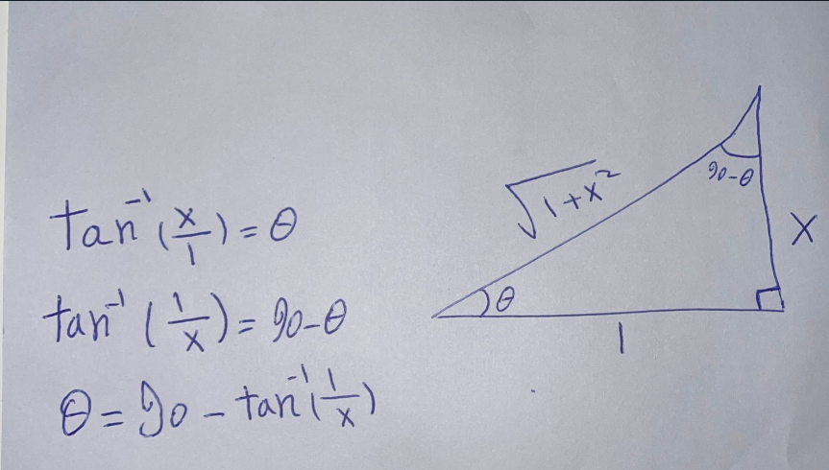
The ArcTan Function
There is the same problem for the radius of converges here !!
9

Slide 11
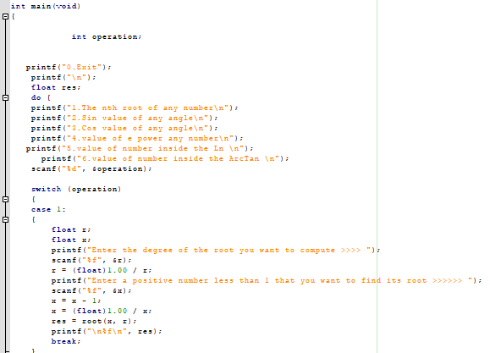
Main function
We used switch case to let the user jump from an operation to the other
10

Slide 12
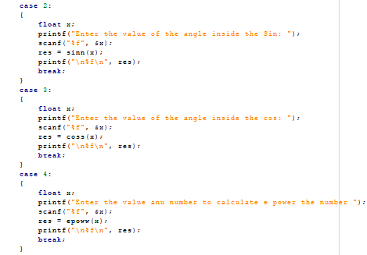
Two Content Layout with Table
11

Slide 13
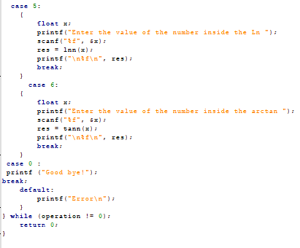
12

Slide 14
Any Questions?
13

Slide 15
THANK YOU!
14

